Slide 1
Plant Anomaly Classification Challenge-Fall 2025
EE470 Project Presentation
Mustafa Gökhan Oyanık
Yusuf Erim Bulca

Slide 2
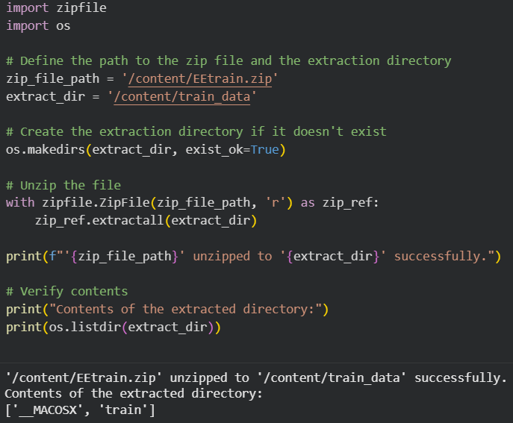
1)Imports and Setup

Slide 3
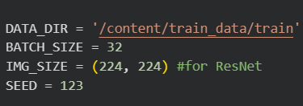
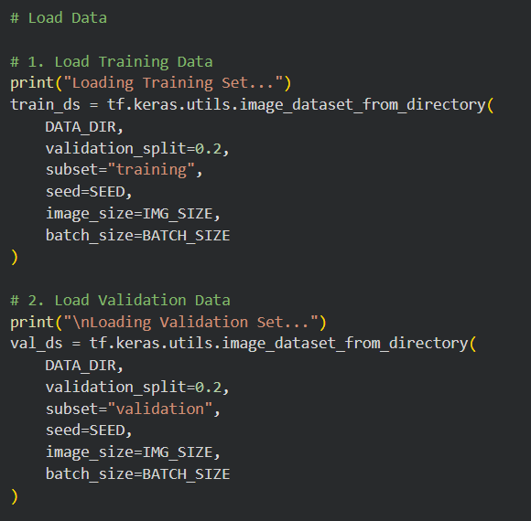
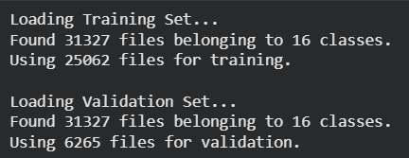
2)Configuration
3)Load Data and Split

Slide 4
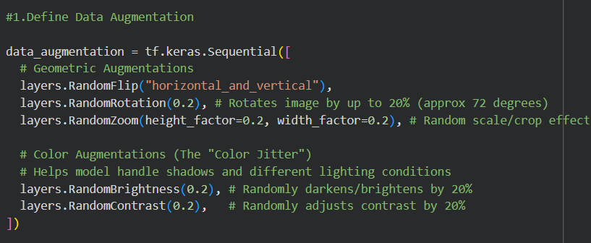
4)Data Augmentation

Slide 5

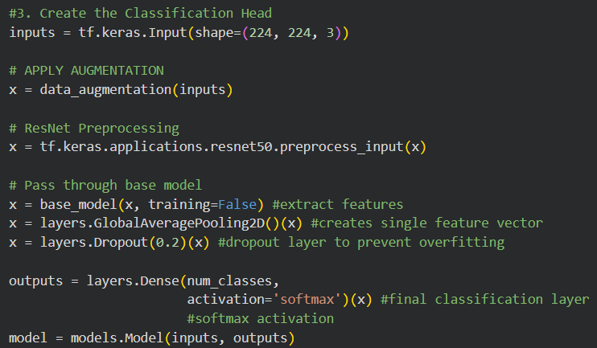
5)The Model

Slide 6


Slide 7
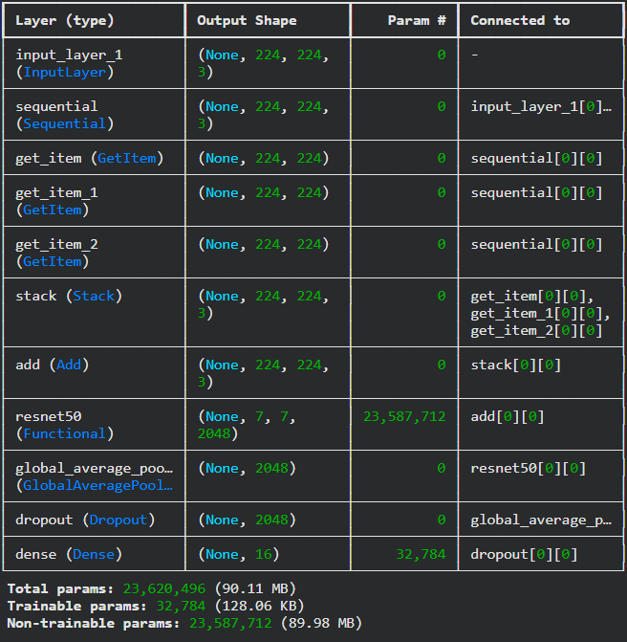
Pre-Trained Feature Extractor
Custom Classifier Layers
Transfer Learning

Slide 8



6)Training The Model

Slide 9
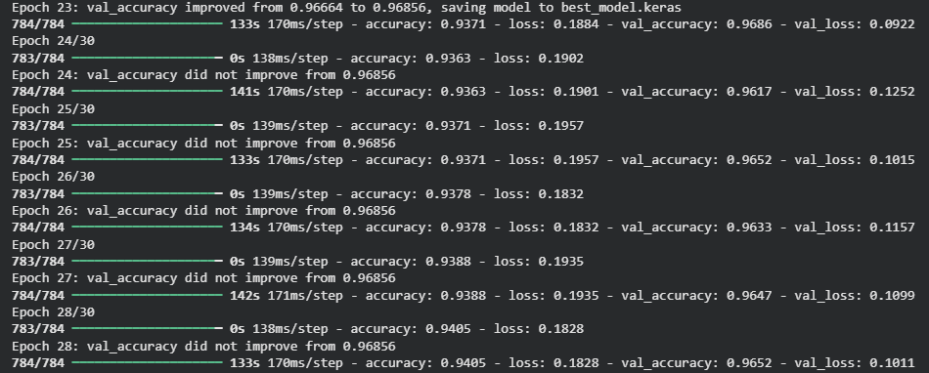
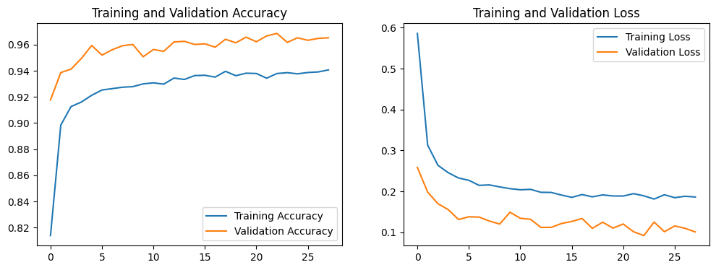
Validation Accuracy

Slide 10
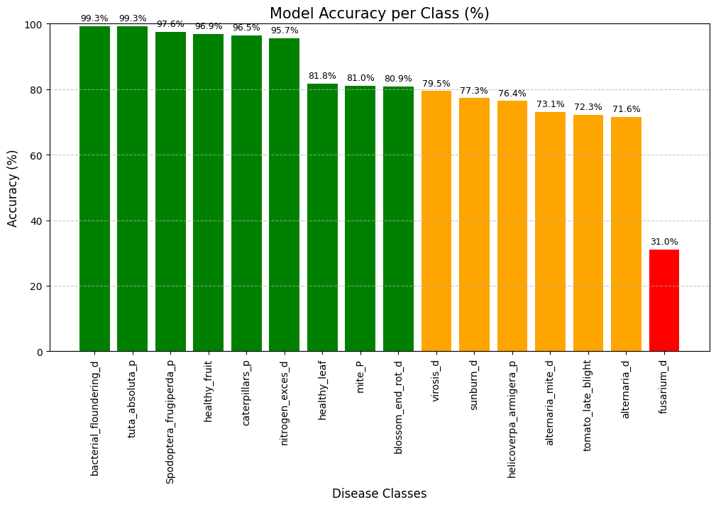
7)Result

